Slide 1
ICS Fall 2017
Lab session 12

Slide 2
Agenda
Unit Project 3 Part 2 Follow-up
Presentation Project Intro

Slide 3
Unit Project 3
Part 2 Follow-up

Slide 4
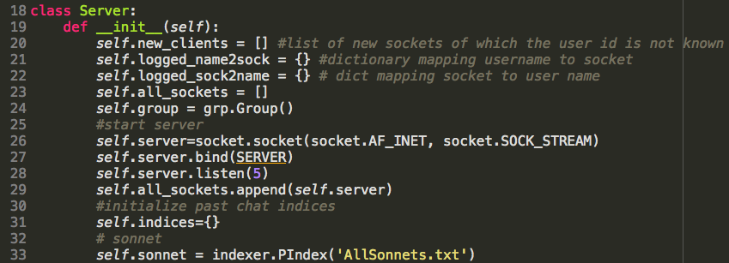
chat_server.py

Slide 5
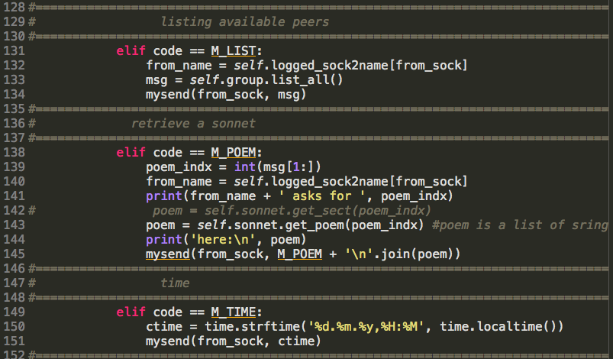
Unit Project 3 Part 2
Sample Solutions
Single-client command handlers: M_LIST, M_POEM, M_TIME
These are independent handlers
The key is to call the right built-in functions

Slide 6
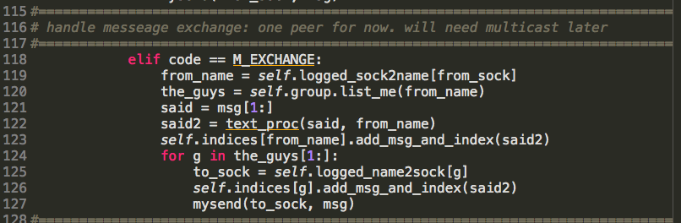
Unit Project 3 Part 2
Sample Solutions
M_EXCHANGE
The real deal among all handlers in chat_server.py
Make sure to add each msg to the appropriate index as you relay them

Slide 7
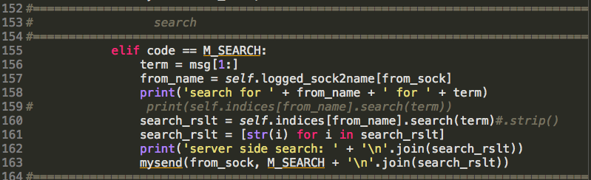
Unit Project 3 Part 2
Sample Solutions
Click to get the solutions of up3
M_SEARCH
Similar to other single-client handlers
But it also requires a bit help from the M_EXCHANGE handler
Due to the indices {}

Slide 8
Presentation Project
Intro

Slide 9
Presentation Project Intro
Have a look at the specifications (you can find it from NYU Class Resource)
Check in with your teammates and select your topic(s)
Email Bing by 10PM, Sunday, 3rd, Dec., about your choice
xg7@nyu.edu
You will need to present in front of your classmates
With live demo and PPT slides
Team info has been sent out
Submit your work to NYU Classes by 3:00AM, Thursday, 14th, Dec.
One submission per group is fine
Judges:
Teaching team
Your peers

Slide 10
Recommend topics

Slide 11

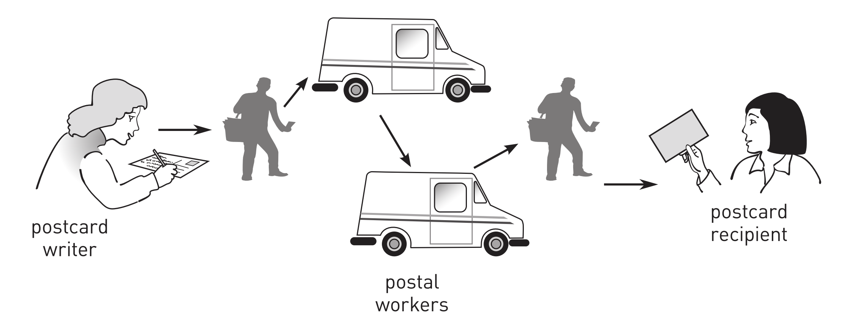
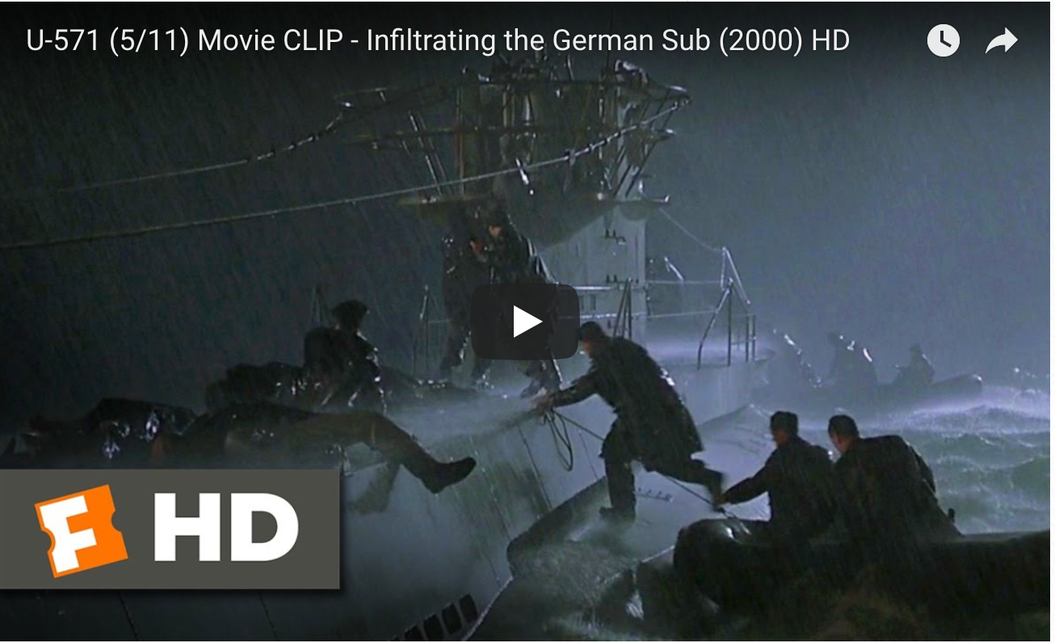
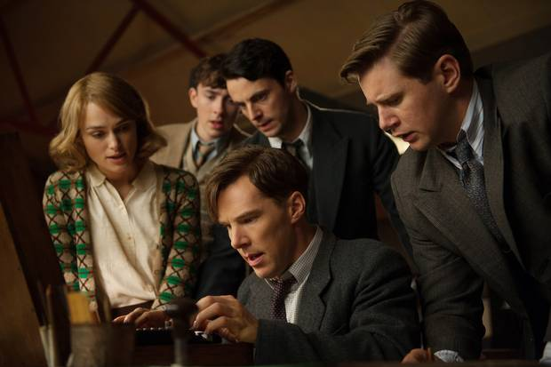
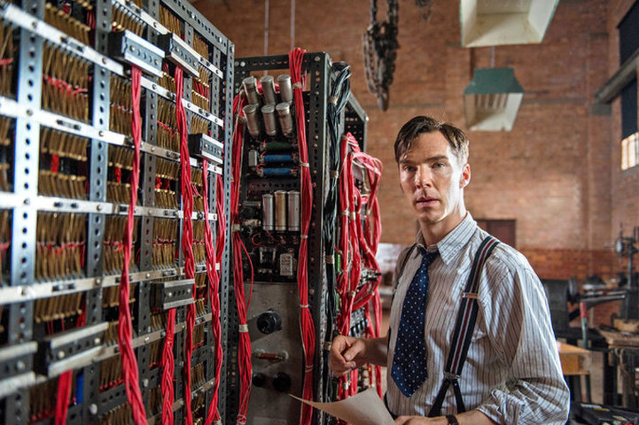
Secure messaging
guard against eavesdropping
The solution:
cryptograph
eavesdropper
Also a topic of Hollywood movies
server
Client 1
Client 2
Reference: Chapter 4, in MacCormick’s Nine algorithms

Slide 12

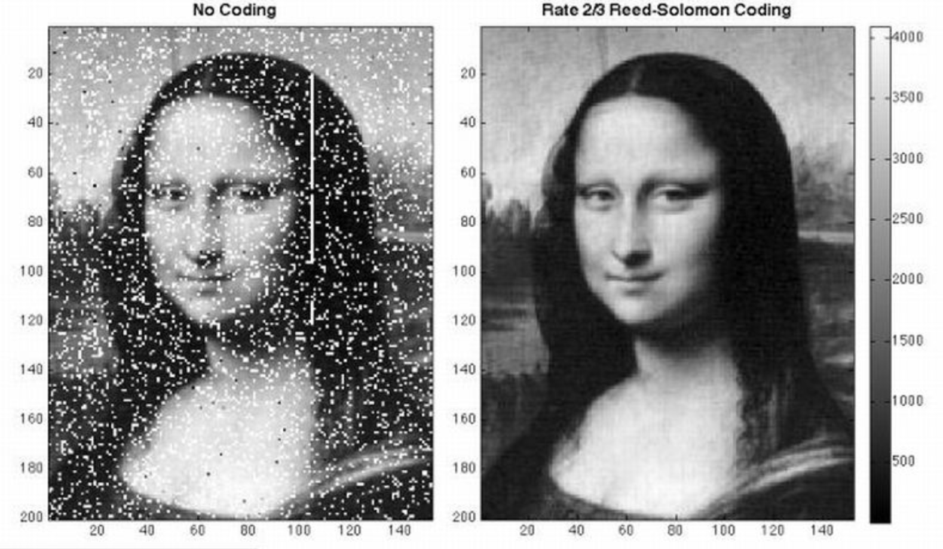
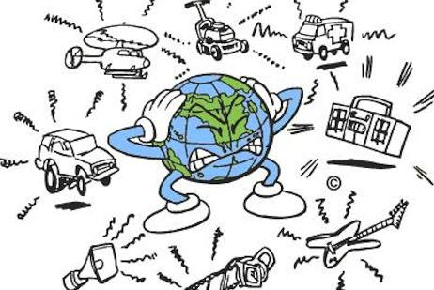

Reliable messaging
protection against a bad communication channel
Detect and correct errors
Reference: Chapter 5, in MacCormick’s Nine algorithms

Slide 13
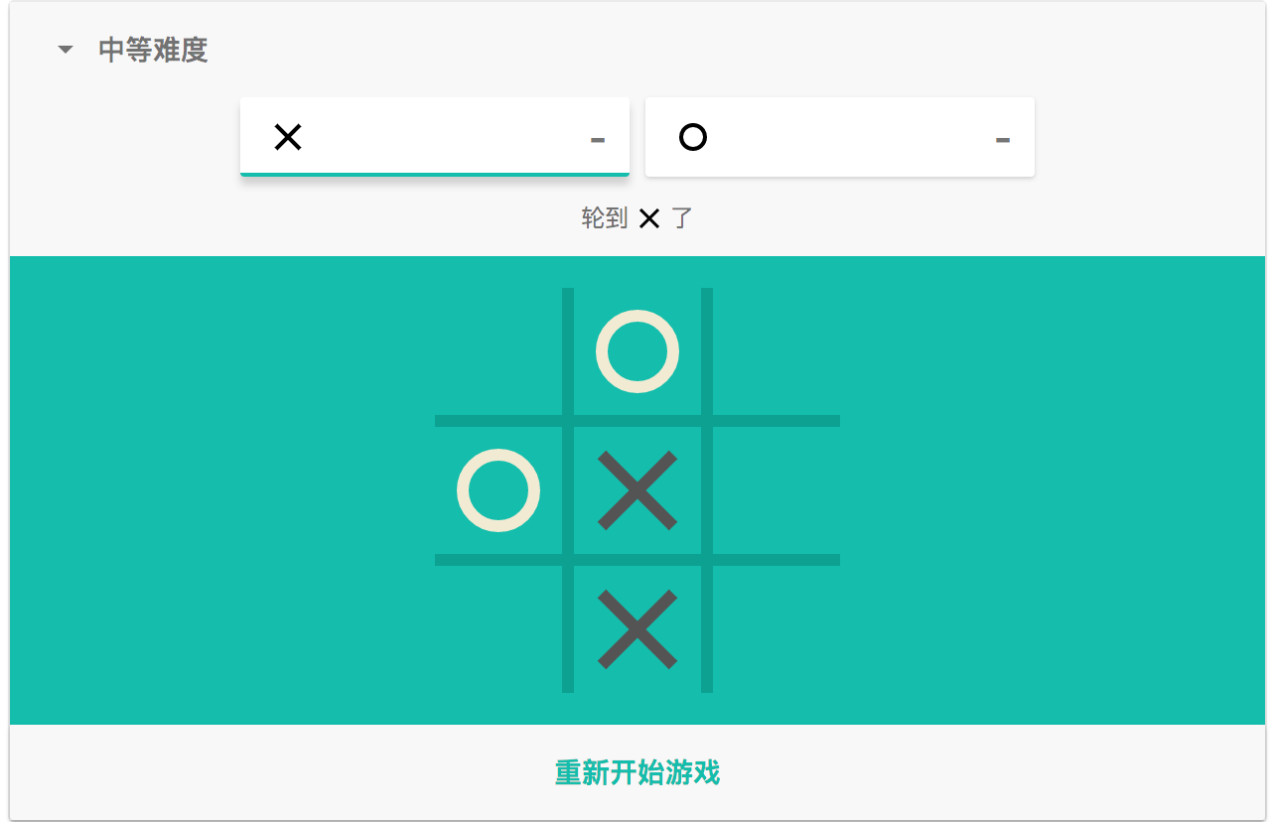
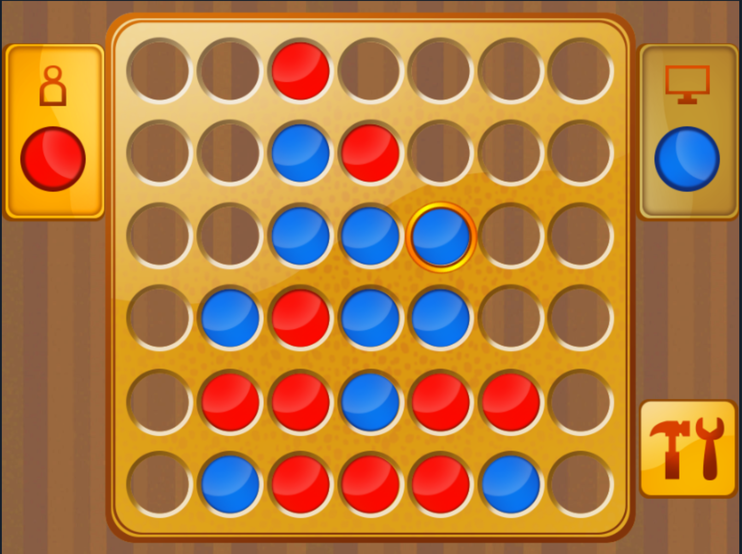
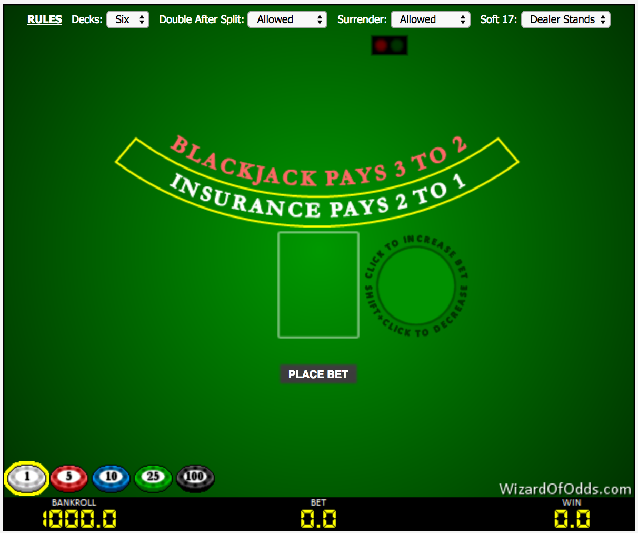
Online gaming
Single player to multiple player!
extend the chat system with game functionality
E.g. tic-tac-toe, poker, tetris
Recall the dice.py we developed before

Slide 14
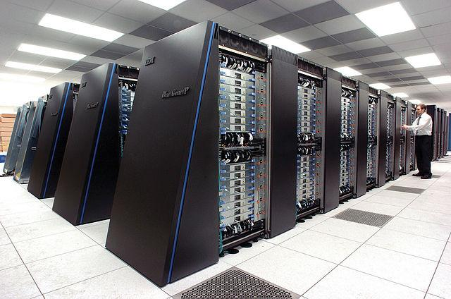
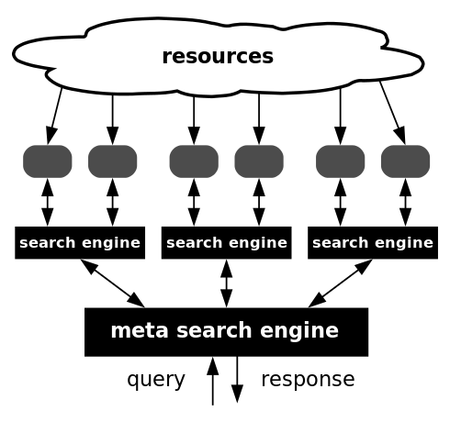
Parallel search engine
The chat system:
proves a way for inter-process communication
you can turn it into a distributed search engine
Parallel computing:
dividing large problems into smaller ones
then, solved them at the same time
the separate tasks may have a varied nature and often require some inter-process communication during execution.
IBM’s Blue Gene, hundreds of devices are connected together

Slide 15
Presentation Project Intro
You will have about two weeks to finalize everything
Time is a bit tight
Better start early
Github would be helpful for collaboration
Remember 90-90 rule!
Here is a gallery of the works done by the students from the past semesters!
Enjoy! (More examples can be found here.)

